Slide 1
Smart Home
AMIT Graduation Project
Presented by: Khaled Mohamed AboSeada

Slide 2
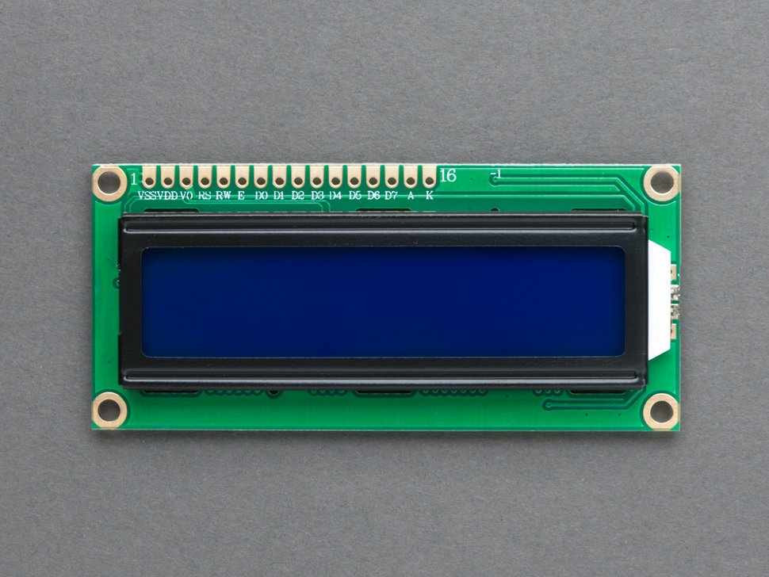
LCD
Liquid Crystal Display (LCD).
Microcontroller has the ability to output important information to a device .
LCD can display characters, string, integer numbers and float numbers.
LCD 16 * 2.

Slide 3
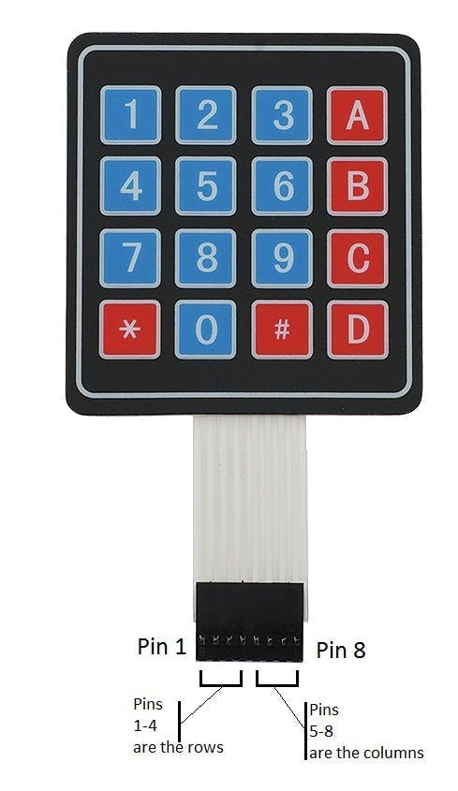
Keypad
One of the microcontroller functions is to receive input form the user.
The input information can be entered through a 16key Membrane Switch keypad

Slide 4
USART
Universal Synchronous and Asynchorous Serial Receiver and Transmitter(USART).
USART is one of Standards in Serial Communication device .
The USART can also be used in Master Serial Peripheral interface (SPI) mode.
USART is serial communication of two protocols.
It can be used for transmitting and receiving the data bit bybit with respect to clock pulses through a single wire.

Slide 5
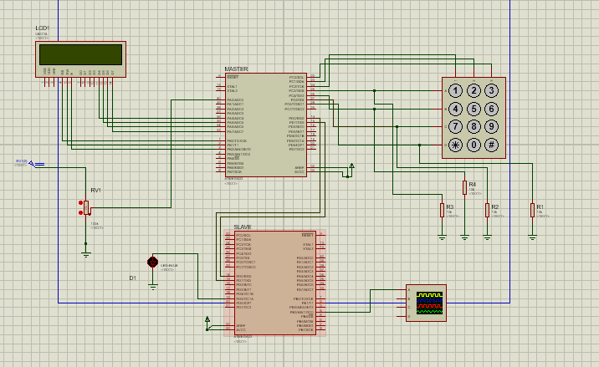
Circuit Diagram

